Slide 1

CNENGR506
Intelligent System Control

Slide 2
Question No 1:
Identify four standard objectives of closed loop control system.
What are the effects of negative feedback in control system?
How does feedback improve the performance of a control system?
In a transfer function, what does the numerator represent, and what does the denominator represent?
In terms of stability, what is the significance of poles in a transfer function?
How can you analyze the stability of a closed-loop control system using the transfer function?

Slide 3
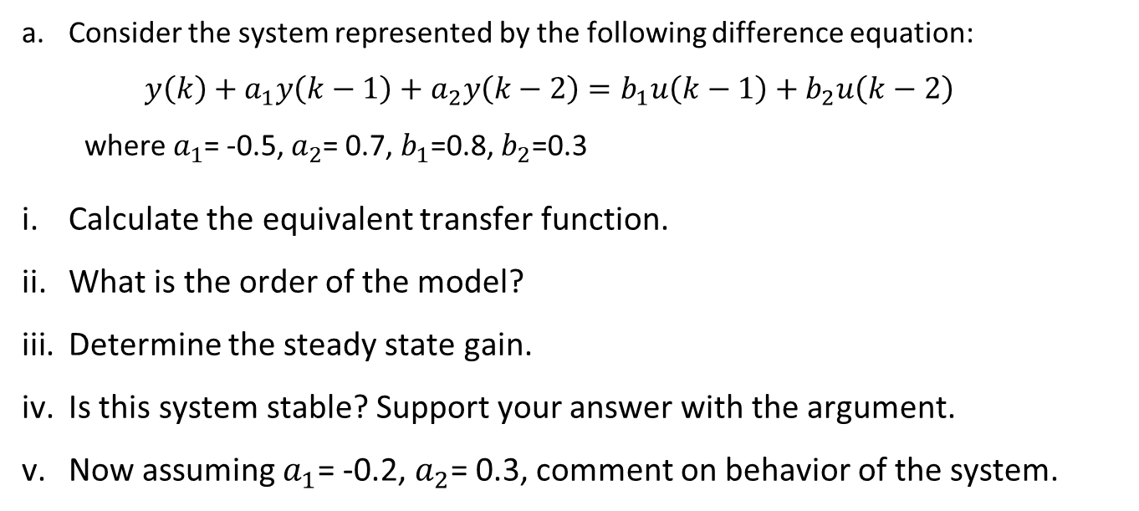
Question No 2:
Consider the system represented by the following difference equation:
$$y\left(k\right)+a_{1}y\left(k−1\right)+a_{2}y\left(k−2\right)=b_{1}u\left(k−1\right)+b_{2}u\left(k−2\right)$$
where $a_{1}$= -0.5, $a_{2}$= 0.7, $b_{1}$=0.8, $b_{2}$=0.3
Calculate the equivalent transfer function.
What is the order of the model?
Determine the steady state gain.
Is this system stable? Support your answer with the argument.
Now assuming $a_{1}$= -0.2, $a_{2}$= 0.3, comment on behavior of the system.

Slide 4
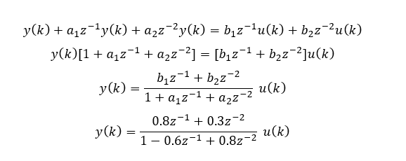

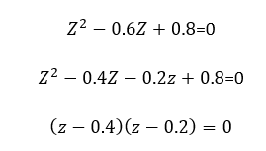
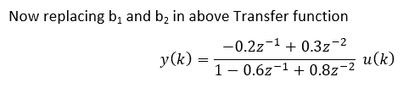
Solution
The stability and steady-state gain are unchanged. However, the new numerator B(z) = −0.2z + 0.3 = 0 has one zero, which lies outside the unit circle, i.e., a value of 0.3/0.2 = 1.5 on the real axis. Consequently, the system is said to be non-minimum phase this yields an initial negative response to the positive step input
Hence, the system is defined by two poles, i.e., p1 = 0.4 and p2 = 0.2, both lying on the real axis of the complex z-plane. In this case, |pi | < 1 (i = 1, 2) and the system is stable.

Slide 5
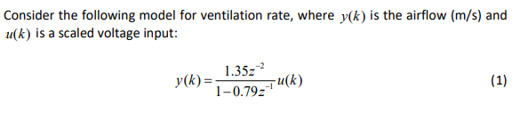
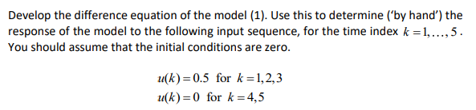

Question No 3:
G = 6.4286
0, 0, 0.6750, 1.2083, 1.6295

Slide 6
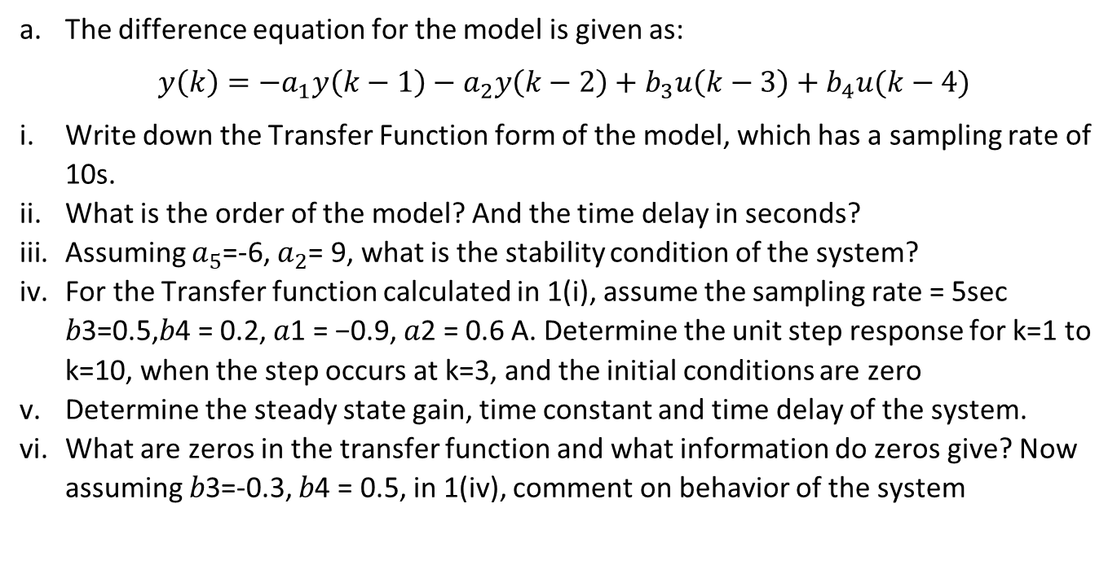
Question No 4:
The difference equation for the model is given as:
$$y\left(k\right)={−a}_{1}y\left(k−1\right)−a_{2}y\left(k−2\right)+b_{3}u\left(k−3\right)+b_{4}u(k−4)$$
Write down the Transfer Function form of the model, which has a sampling rate of 10s.
What is the order of the model? And the time delay in seconds?
Assuming $a_{5}$=-6, $a_{2}$= 9, what is the stability condition of the system?
For the Transfer function calculated in 1(i), assume the sampling rate = 5sec 𝑏3=0.5,𝑏4 = 0.2, 𝑎1 = −0.9, 𝑎2 = 0.6 A. Determine the unit step response for k=1 to k=10, when the step occurs at k=3, and the initial conditions are zero
Determine the steady state gain, time constant and time delay of the system.
What are zeros in the transfer function and what information do zeros give? Now assuming 𝑏3=-0.3, 𝑏4 = 0.5, in 1(iv), comment on behavior of the system

Slide 7
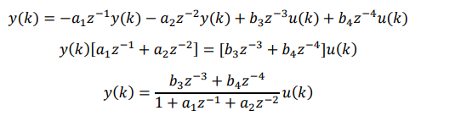

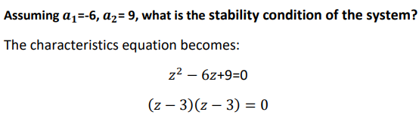
Solution-4
Both poles are 3. At least one pole is greater than unity (in fact, both are) and hence the system is unstable. The poles lie on the real axis of the complex plane, hence the response will exponential

Slide 8
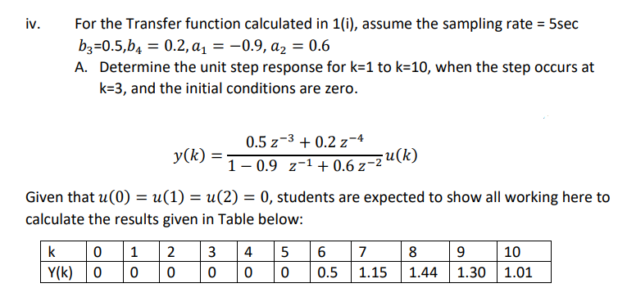
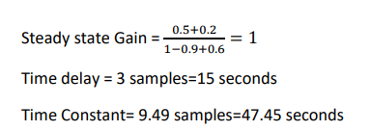

Slide 9
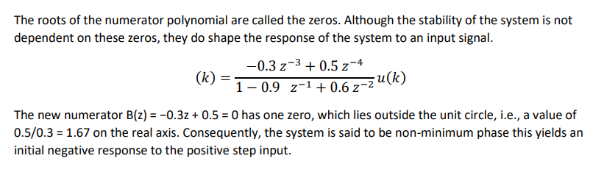
What are zeros in the transfer function and what information do zeros give? Now assuming 𝑏3=-0.3, 𝑏4 = 0.5, in 1(iv), comment on behavior of the system

Slide 10
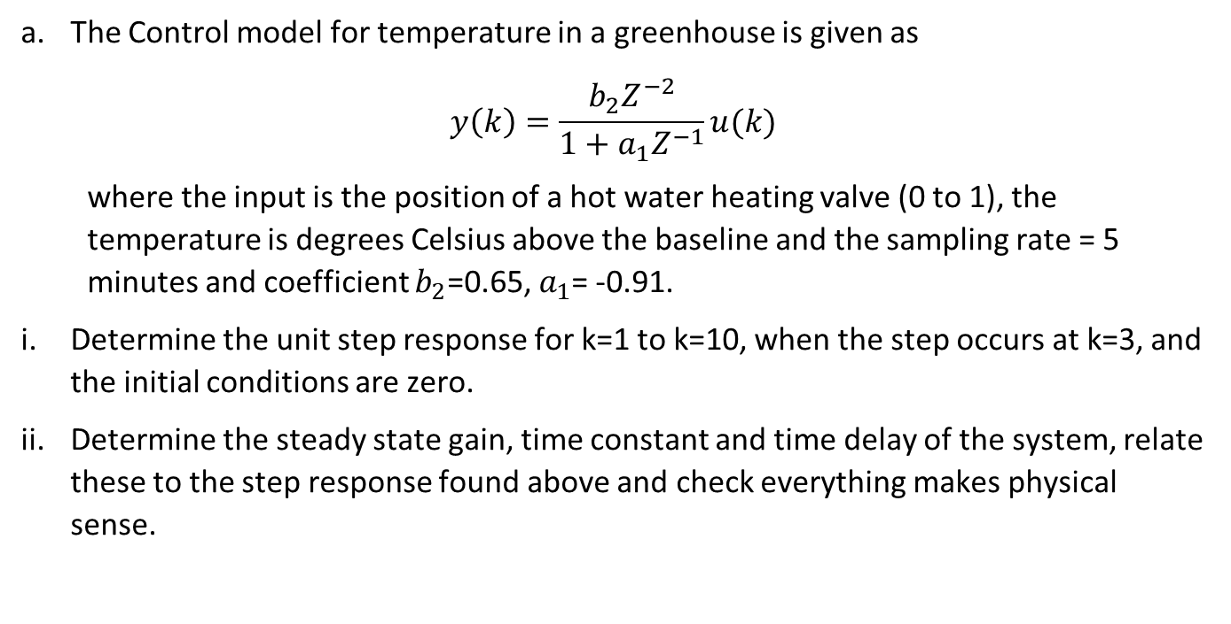
Question No 5: (homework)
The Control model for temperature in a greenhouse is given as
$$y\left(k\right)=\frac{b_{2}Z^{−2}}{1+a_{1}Z^{−1}}u(k)$$
where the input is the position of a hot water heating valve (0 to 1), the temperature is degrees Celsius above the baseline and the sampling rate = 5 minutes and coefficient $b_{2}$=0.65, $a_{1}$= -0.91.
Determine the unit step response for k=1 to k=10, when the step occurs at k=3, and the initial conditions are zero.
Determine the steady state gain, time constant and time delay of the system, relate these to the step response found above and check everything makes physical sense.

